Slide 1
Unit-V
Classic Problems of Synchronization

Slide 2
The bounded buffer problem
Problem Statement:
We have a buffer of fixed size. A producer can produce an item and can place in the buffer. A consumer can pick items and can consume them. We need to ensure that when a producer is placing an item in the buffer, then at the same time consumer should not consume any item. In this problem, buffer is the critical section
To solve this problem, we need two counting semaphores – Full and Empty. “Full” keeps track of number of items in the buffer at any given time and “Empty” keeps track of number of unoccupied slots.

Slide 3
Initialization of semaphores – mutex = 1 Full = 0 // Initially, all slots are empty. Thus full slots are 0 Empty = n // All slots are empty initially

Slide 4
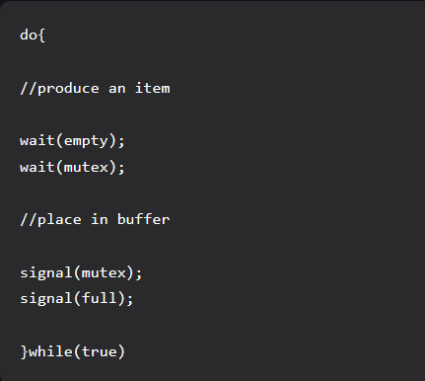
Solution for Producer –

Slide 5
When producer produces an item then the value of “empty” is reduced by 1 because one slot will be filled now. The value of mutex is also reduced to prevent consumer to access the buffer. Now, the producer has placed the item and thus the value of “full” is increased by 1. The value of mutex is also increased by 1 beacuse the task of producer has been completed and consumer can access the buffer.

Slide 6
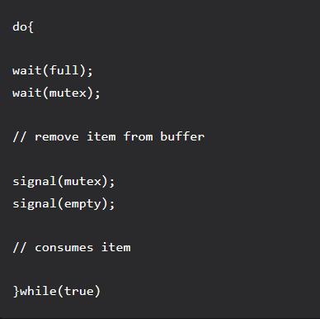
Solution for Consumer

Slide 7
The Readers-Writers Problem.
The readers-writers problem relates to an object such as a file that is shared between multiple processes.
Some of these processes are readers i.e. they only want to read the data from the object and some of the processes are writers i.e. they want to write into the object.
If two readers access the object at the same time there is no problem. However if two writers or a reader and writer access the object at the same time, there may be problems.
To solve this situation, a writer should get exclusive access to an object i.e. when a writer is accessing the object, no reader or writer may access it. However, multiple readers can access the object at the same time.

Slide 8
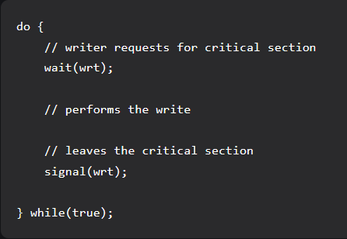
Writer process:

Slide 9
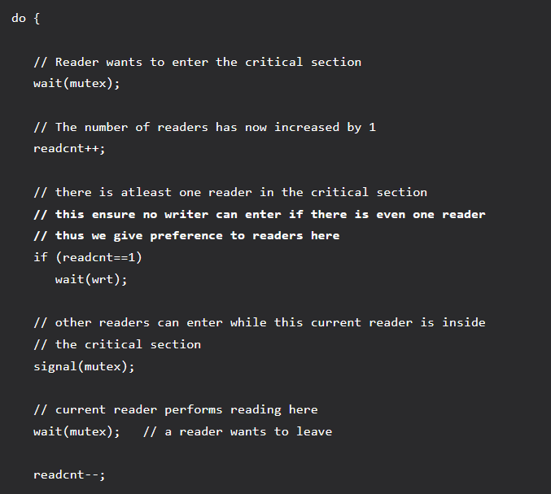
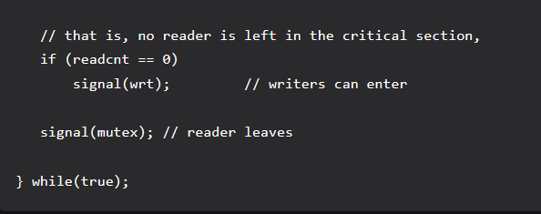
Reader process:

Slide 10
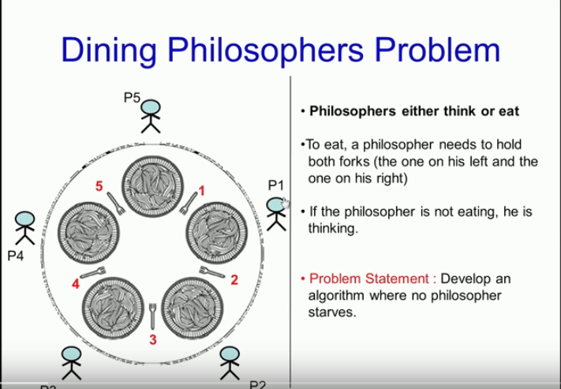
The Dining-Philosophers Problem

Slide 11
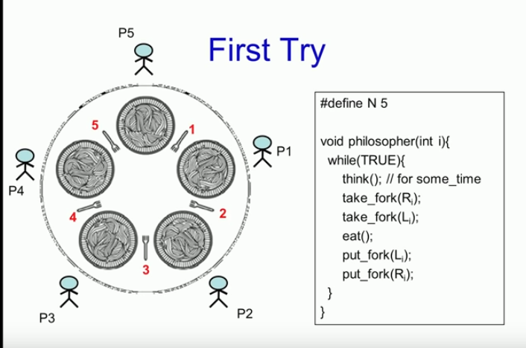

Slide 12
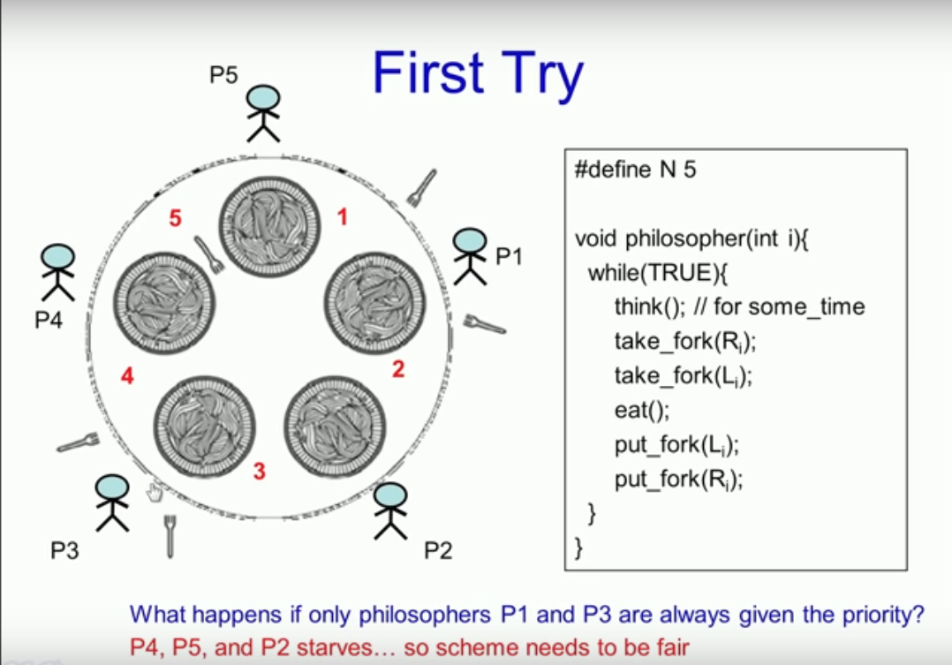

Slide 13
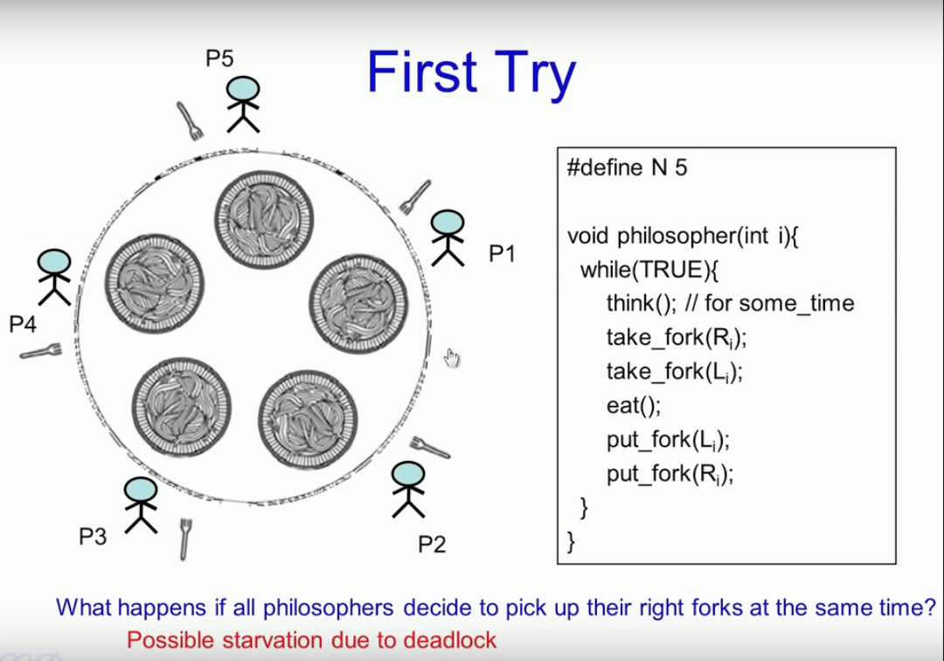

Slide 14
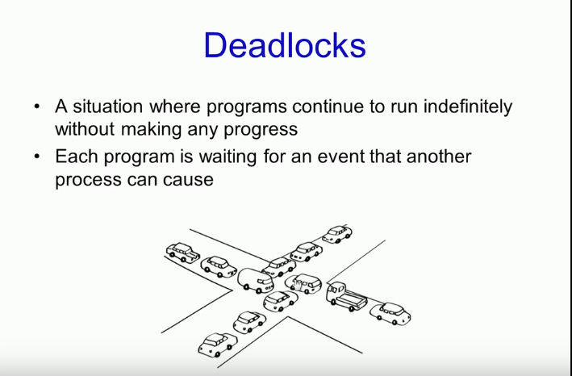

Slide 15
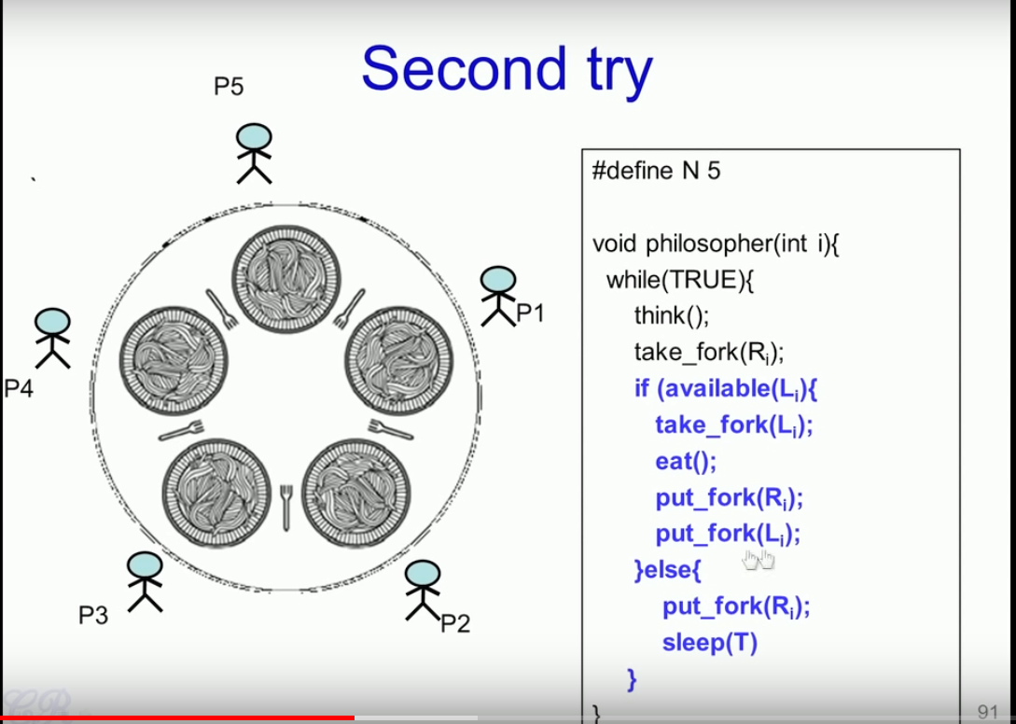

Slide 16
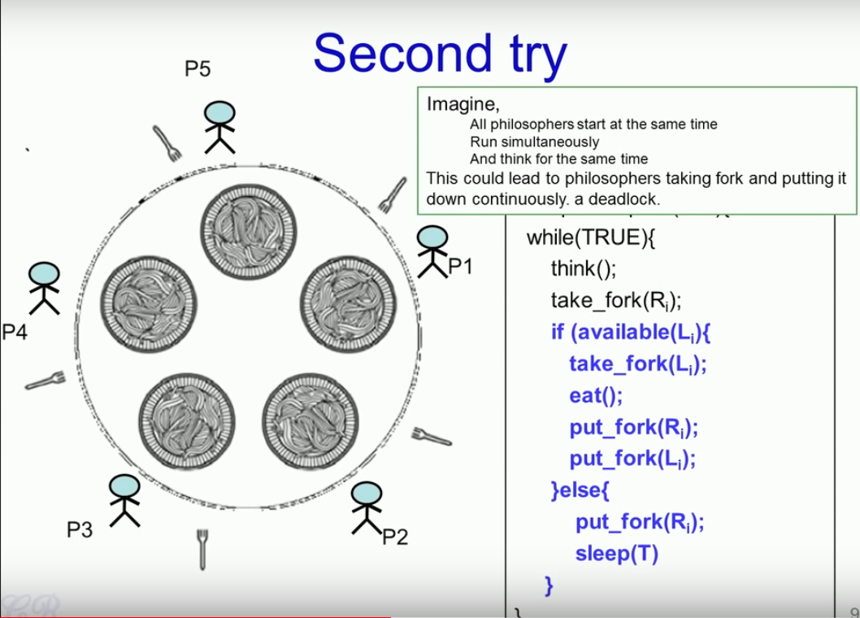

Slide 17
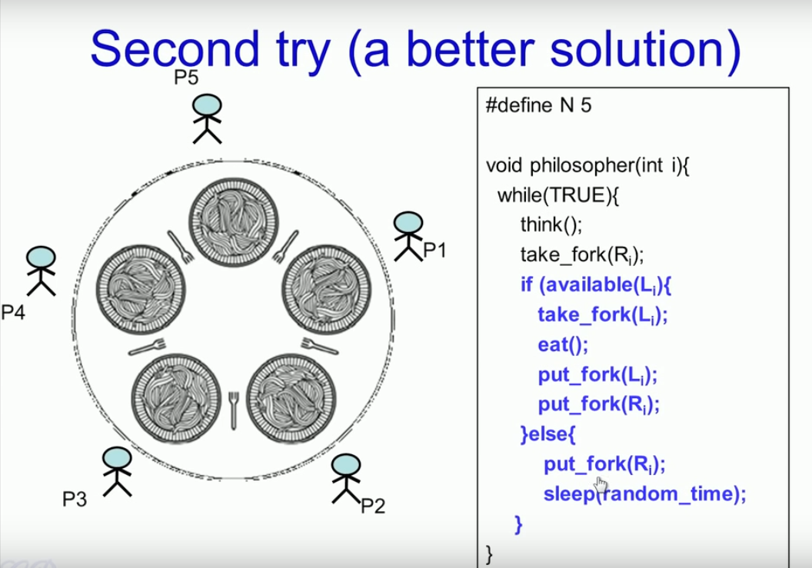

Slide 18
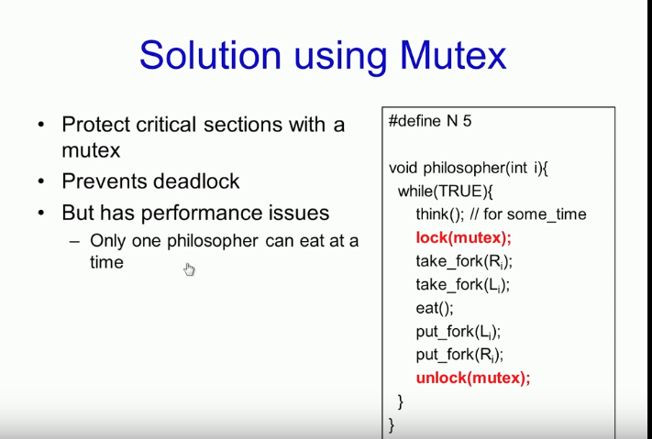

Slide 19
